Slide 1
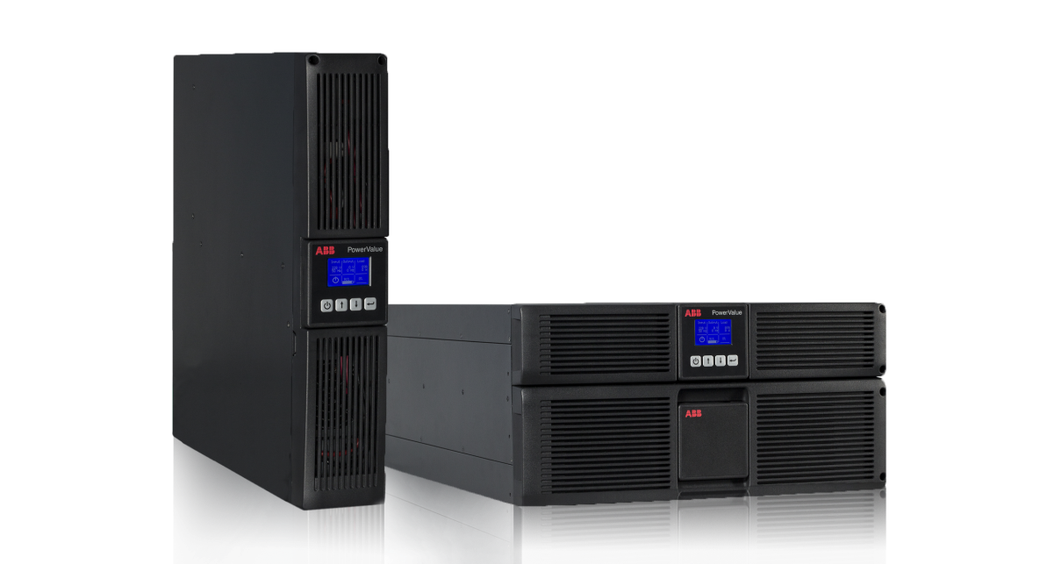
PowerValue 11 RT
True double-conversion online single-phase UPS
Sales Presentation

Slide 2
PowerValue 11 RT 1-10 kVA
Contents
Applications
Product Overview
Performance
Mechanical Design
Battery Configuration
User Interface / Software and connectivity
Options and accessories
Maintenance and Service
Conclusion

Slide 3

PowerValue 11 RT 1-10 kVA
1-Phase Applications
  Small-to-Medium size Enterprises
  Computer rooms
  Server rooms
  Control systems
  IT networks
  Telephone systems
  CCTV
  Medical / Healthcare
  Education…
The amount of data managed in the above environments is growing.
ABB recognizes the need to guarantee your business continuation by protecting your equipments and data.

Slide 4
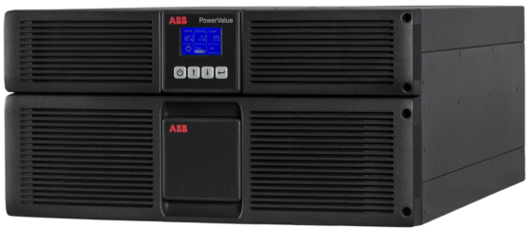
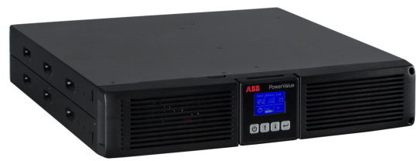
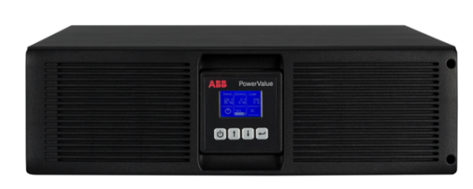
PowerValue 11 RT 1-10 kVA
Product Overview
1-3 kVA
6 kVA
10 kVA
Advanced protection for small and medium enterprises / datacenters / networking / infrastructure and several other power critical applications
  Up to 10kVA capacity with paralleling capability
Notes:
Small datacenters / small to medium size offices and several other low power environments are built today on a large amount of data. This
Applications: Servers / point of sale

Slide 5
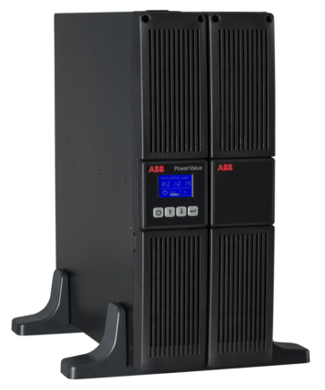
PowerValue 11 RT 1-10 kVA
Performance Characteristics
Technical Highlights
Classification IEC/EN 62040-3 VFI-SS-111
Working mode on-line double conversion
Module power rating 1-10 kVA
Paralleling 2 units (6-10 kVA)
Output power factor 0.9
Efficiency in double conversion up to 93%
Efficiency in eco-mode up to 97%
Maximum weight w/out batteries 28.1 kg
Input current distortion THDI <5 %
Input power factor (PF) 0.99
Communication cards SNMP / Relay Card

Slide 6
PowerValue 11 RT 1-10 kVA
Saving power and costs
Higher power factor
vs 0.8 p.f. means 12.5%
vs 0.7 p.f. means 28.6%
0.9
more active power
Higher Efficiencies
Competitor A | Competitor B | Competitor C | PowerValue
up to 92% (1-10kVA) | up to 91% (1.1-3kVA) up to 92% (5-11kVA) | up to 88% (1-3kVA) up to 92% (4.5-10kVA) | up to 92% (1-3kVA) up to 93% (6-10kVA)
Up to 25% | Up to 14.3% | Up to 50% | Lower losses

Slide 7
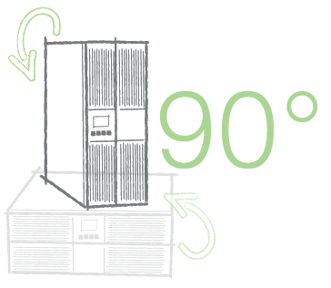
PowerValue 11 RT 1-10 kVA
Mechanical Design
Rack / tower convertible
Compact Design
Small weight
Easy serviceability
Single and dual input feed (6-10 kVA)

Slide 8
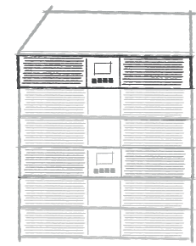
PowerValue 11 RT 1-10 kVA
Redundancy and paralleling
Up to 4 battery modules / UPS
+
Up to 2 UPS in parallel (6-10kVA)
+
+
+
+

Slide 9
PowerValue 11 RT 1-10 kVA
Other Features
Eco-Mode
Fan speed control
Cold start
Generator compatible
Input/output transformer compatible
Temperature compensation system

Slide 10
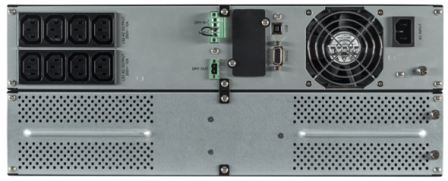
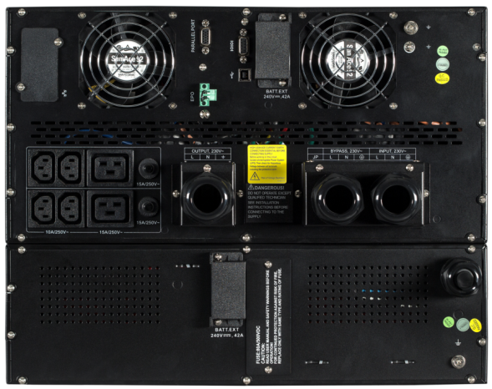
PowerValue 11 RT 1-10 kVA
1
4
5
Input: Advanced input filtering for higher performances
Bypass: Dual input feed (6-10kVA)
Battery: Runtime is easily extendable
Output: Multiple wiring options adapts to all needs
Fans: Fan speed control for reduced losses
3
1
2
3
3
5
4
4
1
5
2

Slide 11

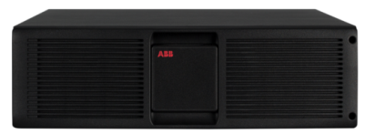
PowerValue 11 RT 1-10 kVA
Battery Configuration
UPS
External Battery Module
POWER (kVA) | INTERNAL BATTERIES | CHARGING CURRENT
1 kVA | 3 x 12V x 7.2Ah | 1.5 A
2 kVA | 4 x 12V x 9Ah | 1.5 A
3 kVA | 6 x 12V x 9Ah | 1.5 A
6 kVA | - | 8 A
10 kVA | - | 8 A
POWER | BATTERY
1 kVA | 6 x 12V x 7.2Ah
2 kVA | 8 x 12V x 7.2Ah
3 kVA | 12 x 12V x 7.2Ah
6 kVA | 15 x 12V x 9Ah
10 kVA | 20 x 12V x 9Ah
Battery Autonomy
 | 1 kVA | 2 kVA | 3 kVA | 6 kVA | 10 kVA
UPS Internal Batteries | <4 / 8 | 4 / 11 | 4 / 11 | - | -
UPS +1 Batt Module | 16 / 40 | 12 / 29 | 13 / 31 | 6 / 16 | 5 / 13
UPS +2 Batt Modules | 32 / 76 | 22 / 54 | 23 / 56 | 16 / 36 | 13 / 29
UPS +3 Batt Modules | 52 / 119 | 32 / 78 | 35 / 82 | 26 / 59 | 20 / 47
UPS +4 Batt Modules | 68 / 166 | 45 / 105 | 49 / 111 | 36 / 84 | 29 / 68
-in minutes at full / half load
-given runtimes are estimates and valid at 20 degrees Celsius. Actual runtime of the system will depend, among many variables, on the age of the batteries and environmental conditions

Slide 12
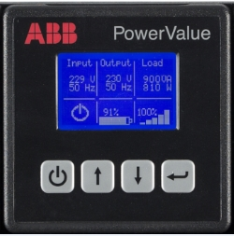
PowerValue 11 RT 1-10 kVA
User Interface / SW & Connectivity
User-friendly graphical interface:
UPS Status: To quickly and easily understand the status of the UPS
Event Log: To access to the events registered for self diagnosis
Measurements: To monitor currents / voltages / power / available runtime and other important characteristics
Control: To start-up / shut-down / transfer between operating modes and perform battery tests
UPS Identification: To identify the UPS model / serial number and firmware version
Settings: To adjust the UPS settings to your needs
Most important information always available at first glance

Slide 13
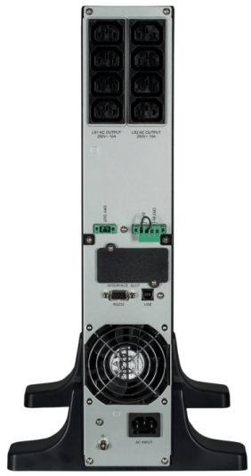
PowerValue 11 RT 1-10 kVA
Software and connectivity
Dry ports
Slot for optional communication card:
  SNMP Card
  AS400 Relay Card
RS232 on USB port (UPS Protocol)
RS232 on D-Sub 9P port (UPS Protocol)

Slide 14
PowerValue 11 RT 1-10 kVA
New
Options and Accessories
  Connectivity
    SNMP Card (CS121 – Version higher than XXX)
    AS400 Relay Card
    NEW ! Winpower SNMP Card
  Rack Mounting kit
    For 1-3kVA
    For 6-10kVA
  Electrical
    NEW ! Bypass PDU 16 A (PowerValue 11 RT 1-3 kVA)
  NEW ! 6 months warranty extension
    For 1-3kVA
    For 6-10kVA

Slide 15
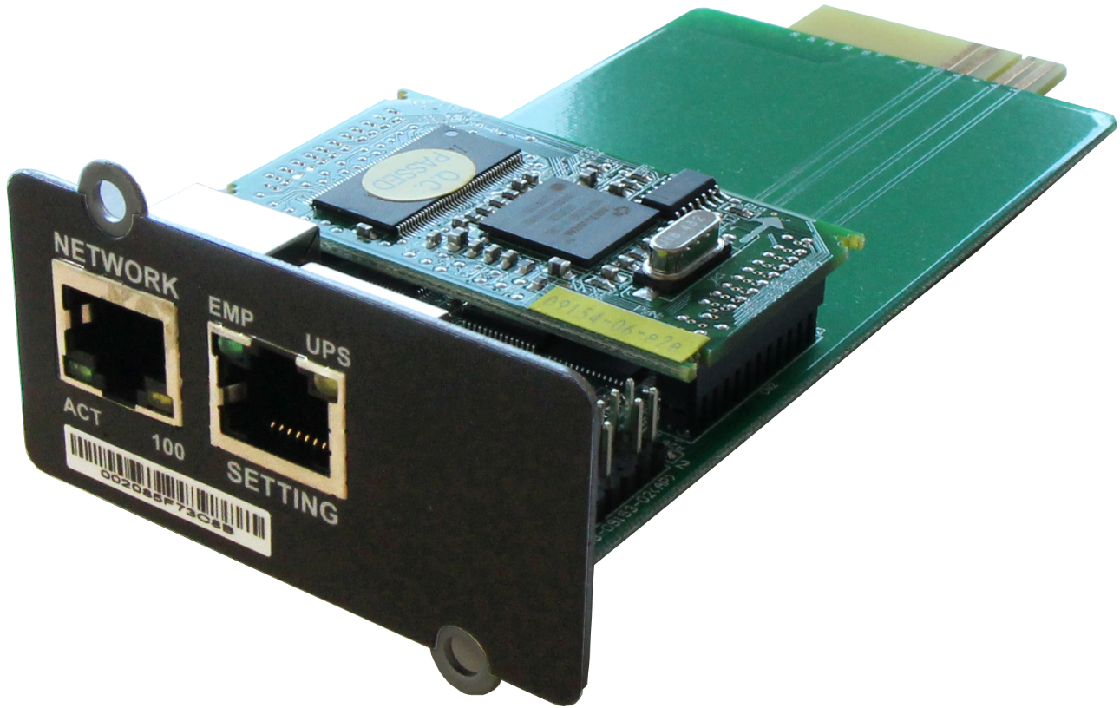
PowerValue 11 RT 1-10 kVA
New
Options and Accessories
  NEW ! Winpower SNMP Card PowerValue
    Fully compatible throughout PowerValue 11 RT family
    Full functionalities to interact with the UPS
    Note: ModBus not supported
    SPS software for safe PC shutdown
    Reduced price
    Bundle option (UPS+NMC) for
    PowerValue 11 RT
Art.nr | Description | Ready to quote | Order acceptance | First shipments
4NWP100110R0001 | Winpower SNMP card PowerValue | May 17th, 2016 | June 21th, 2016 | June 28th, 2016

Slide 16
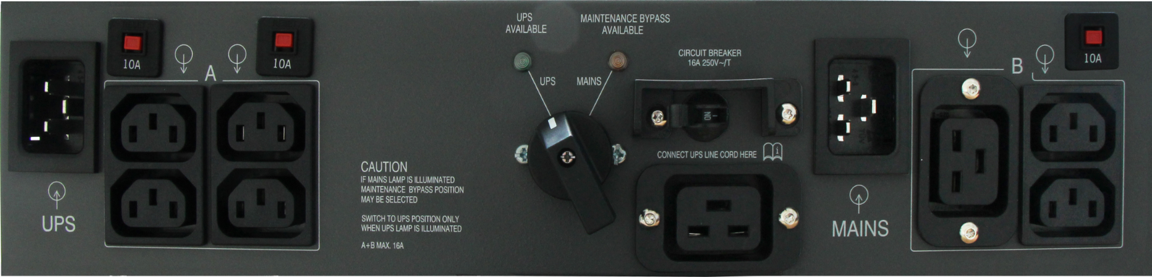
PowerValue 11 RT 1-10 kVA
New
Options and Accessories
NEW ! Bypass PDU 16 A (PowerValue 11 RT 1-3 kVA)
  It provides maintenance bypass capability plus serves as an output Power Distribution Unit
  it provides service continuity during UPS maintenance or upgrade with no load interruptions
  Easy-to-use through a manual rotary switch
  Easy-to-connect, plug and play connectability both at input and output
  Easy-to-install, rack (19’’) mounting brackets included
Art.nr | Description | Ready to quote | Order acceptance | First shipments
4NWP101737R0001 | Bypass PDU 16A PowerValue 11 RT | May 17th, 2016 | June 6th, 2016 | June 13th, 2016

Slide 17
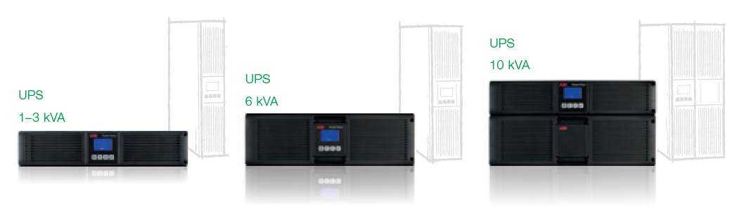
PowerValue 11 RT 1-10 kVA
Safeguarding your power supply has never been easier!

